Slide 1
Vehicle Crash -Risk Prediction
-Bei He

Slide 2
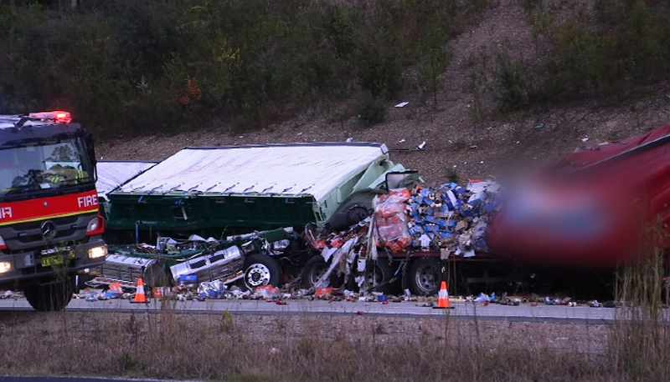
2-Sep 6:15pm QLD A Pedestrian died after being hitted by a car
4-Sep 5am NSW A driver was killed when his truck hitted another truck parked in a stopping bay.
29-Aug Adelaide SA A 31-year-old mum was struck by vehicle and died.

Slide 3
434,000 persons involved
17.67%
From 2006
VIC
155,000 persons light injury
73,000 persons serious injury
3,731 persons killed

Slide 4
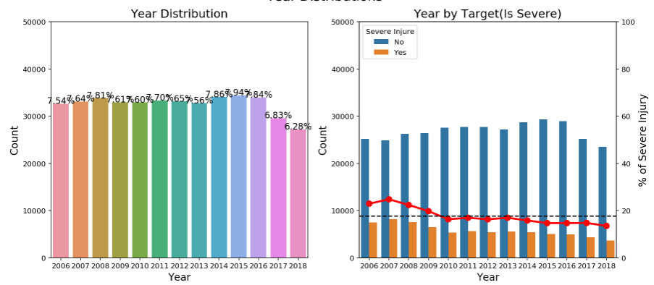

Slide 5
Why?
AWARENESS
Drunk/Drug Driving
Rainning & Slippery surface
Night Driving
Distracted Driving
Running Red Lights
Animal Crossings
Construction Sites
... to be continue

Slide 6
Too Common ! IGNORED
Did you put more
attention on driving
after you see this?

Slide 7
You are in a high risk area. 💣

Slide 8
Machine Learning
Factors:
Location, Time, Speed Zone, Weather,
Road User Type, Light Condition, etc.
Data
Model
Train
Predict
VicRoads
Algorithm

Slide 9
Accuracy
Cover 2/3 Serious Injury
Some Factors are important
but not applicable to the app
E.g. AGE

Slide 10
Examples:
Sat 5:00pm Dusk
Monash 80km/h Raining Wet surface
Driving a car
Tue 5:00am Dawn
Richmond 60km/h
Clear Dry Surface
Driving a car
high risk

Slide 11
Tuning Your app
High Risk Probability
over 40%
High Risk Probability
over 70%
Threshold

Slide 12
17.67% 0%
Goal

Slide 13
THANKS! 😉
You can find me at
hebeiwork@gmail.com
https://www.linkedin.com/in/bei-he/

